Slide 1

7th Grade Math
Unit 11, Lesson 7 Translating Between Representations of Proportional Relationships Volume 2, pg. 182

Slide 2


Benchmarks
MA.7.AR.4.2
Determine the constant of proportionality within a mathematical or real-world context given a table, graph, or written description of a proportional relationship.
MA.7.AR.4.4
Given any representation of a proportional relationship, translate the representation to a written description, table, or equation.
volume 2, pg. 182

Slide 3
Integrated Mathematical Thinking and Reasoning Standards
MA.K12.MTR.2.1 Demonstrate understanding by representing problems in multiple ways.
MA.K12.MTR.3.1 Complete tasks with mathematical fluency.
MA.K12.MTR.7.1 Apply mathematics to real-world contexts.
volume 2, pg. 182

Slide 4

Learning Targets
I can determine the constant of proportionality of a proportional relationship.
I can translate a given representation of a proportional relationship to a written description, table, or equation.
volume 2, pg. 182

Slide 5

Warm-Up
volume 2, pg. 182

Slide 6
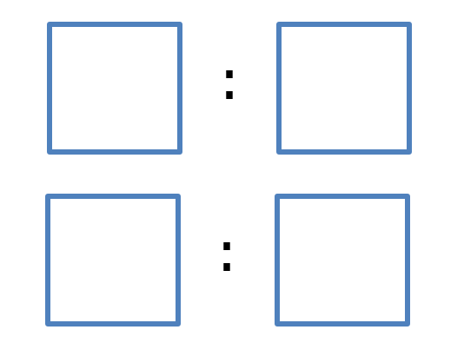
11.7.1 Warm-Up: Equivalent Ratios
Fill in the blue boxes using the digits $1$ to $9$ to make two ratios that are equivalent to $20 :30$.
volume 2, pg. 182

Slide 7

Guided Instruction
volume 2, pg. 183

Slide 8
11.7.2 Guided Instruction: Translating Between Different Representations of Proportional Relationships
The graph of a proportional relationship is shown.
volume 2, pg. 183

Slide 9
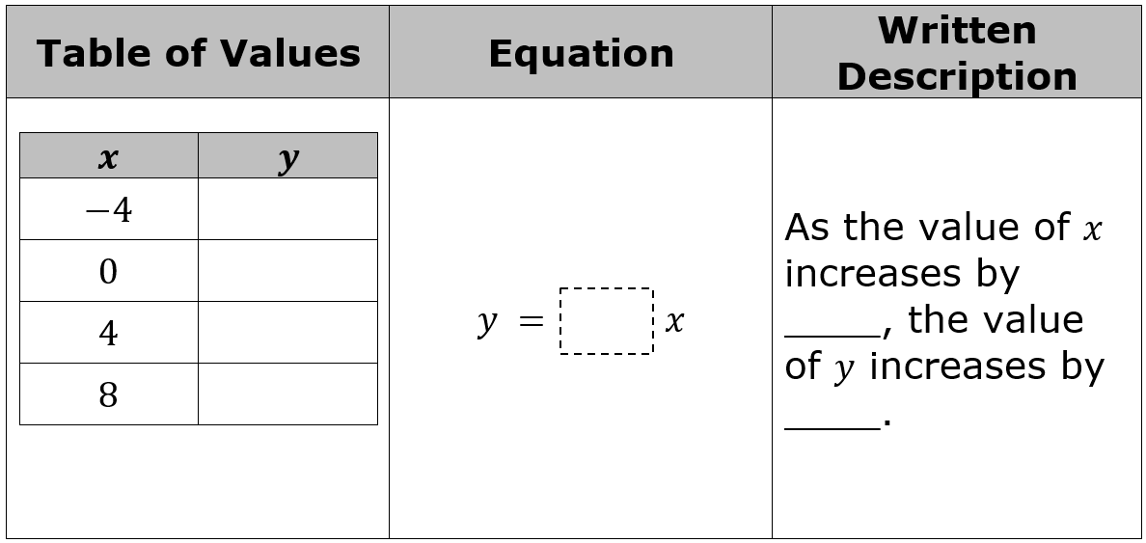
Complete the representations of the proportional relationship by filling in the blanks in the chart.
volume 2, pg. 183

Slide 10
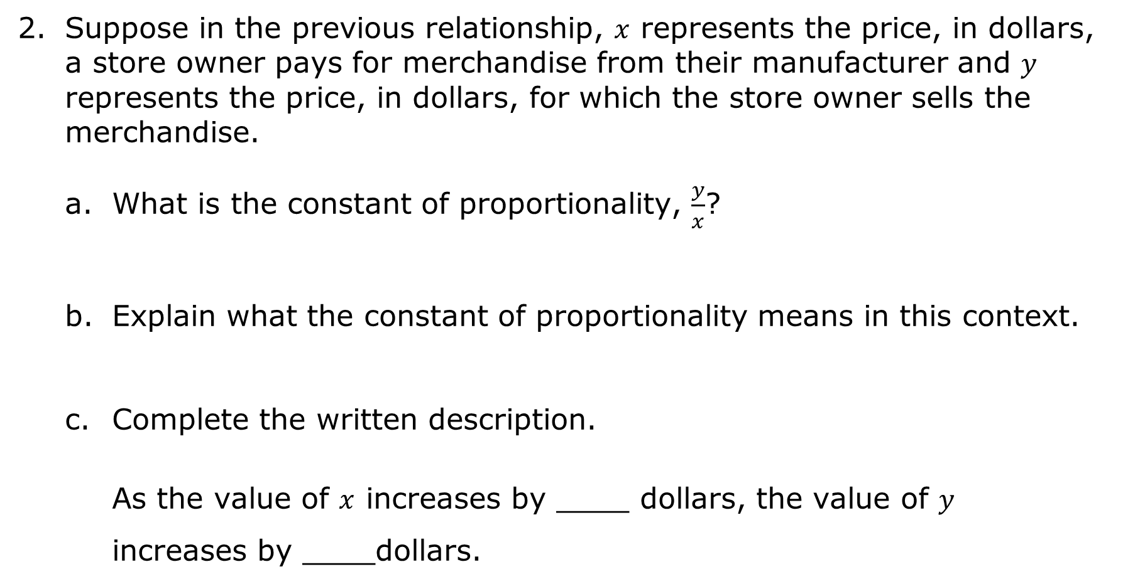
Suppose in the previous relationship, $x$ represents the price, in dollars, a store owner pays for merchandise from their manufacturer and $y$ represents the price, in dollars, for which the store owner sells the merchandise.
What is the constant of proportionality, $\frac{y}{x}$?
Explain what the constant of proportionality means in this context.
Complete the written description.
As the value of $x$ increases by ____ dollars, the value of $y$ increases by ____dollars.
volume 2, pg. 183

Slide 11
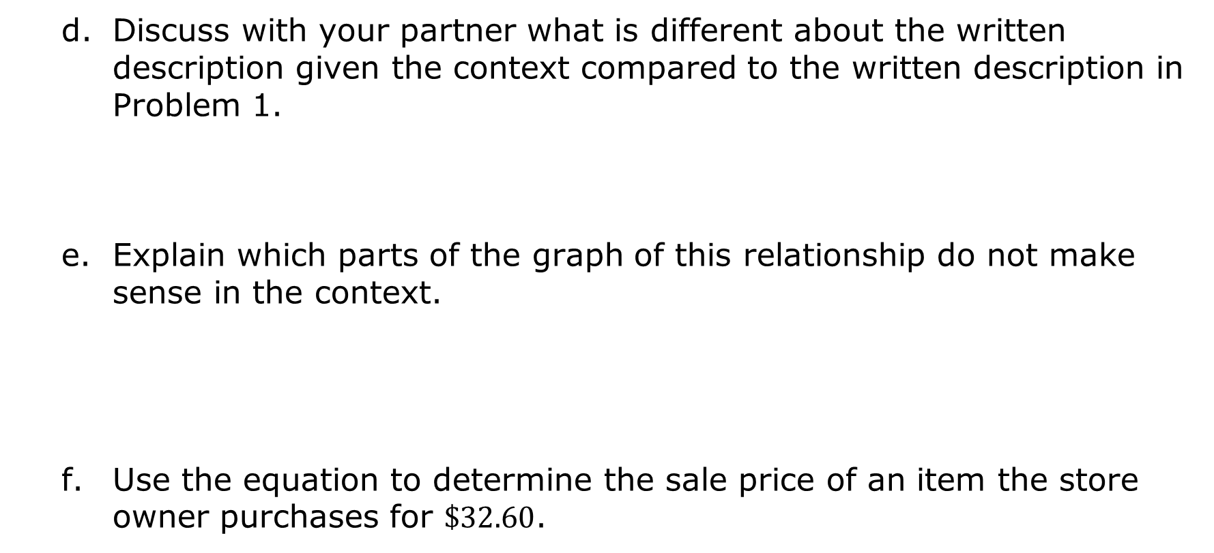
Discuss with your partner what is different about the written description given the context compared to the written description in Problem 1.
Explain which parts of the graph of this relationship do not make sense in the context.
Use the equation to determine the sale price of an item the store owner purchases for $\$32.60$.
volume 2, pg. 183

Slide 12
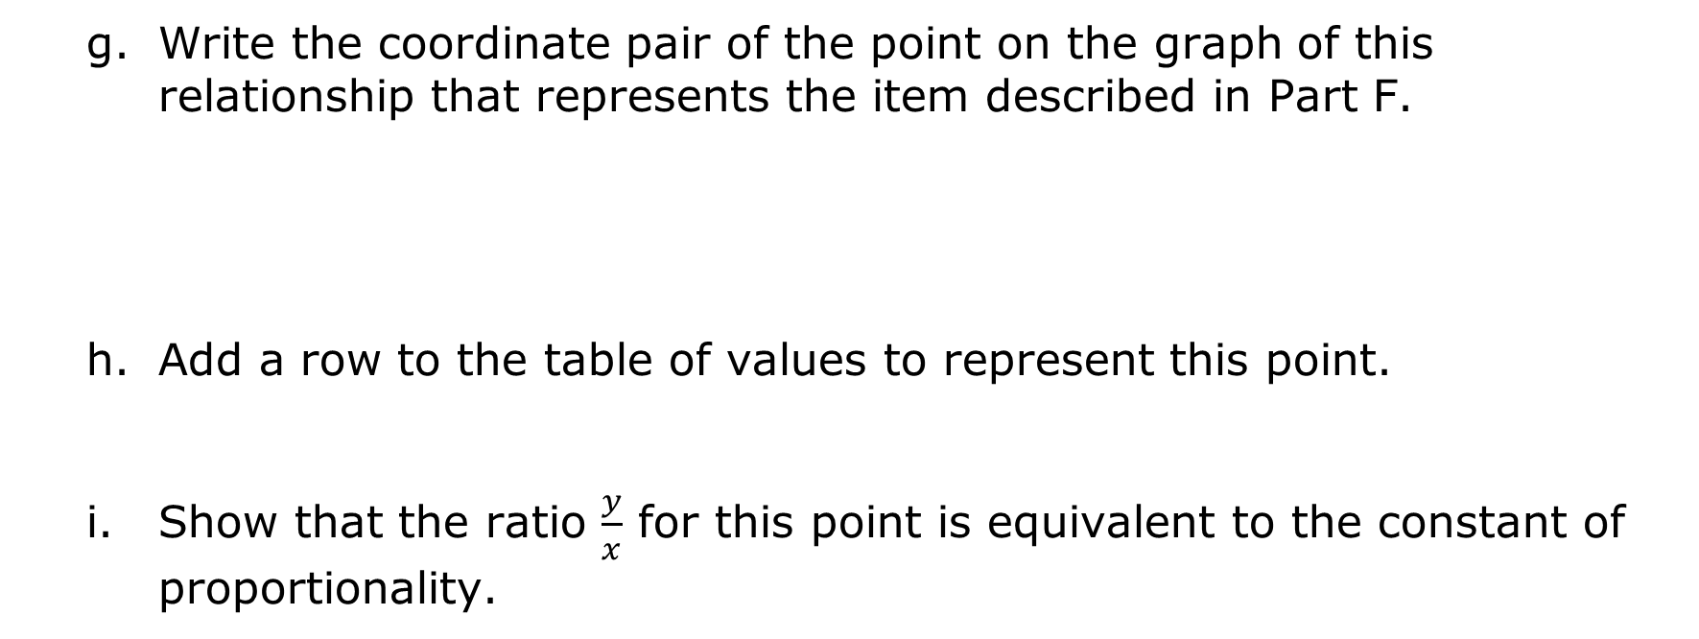
Write the coordinate pair of the point on the graph of this relationship that represents the item described in Part F.
Add a row to the table of values to represent this point.
Show that the ratio $\frac{y}{x}$ for this point is equivalent to the constant of proportionality.
volume 2, pg. 184

Slide 13

Guided Practice
volume 2, pg. 184

Slide 14

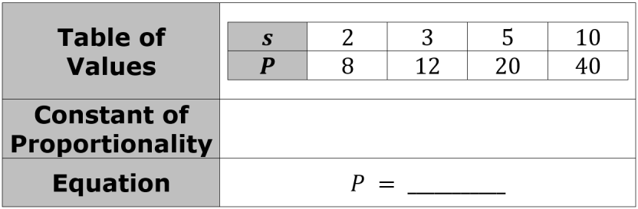
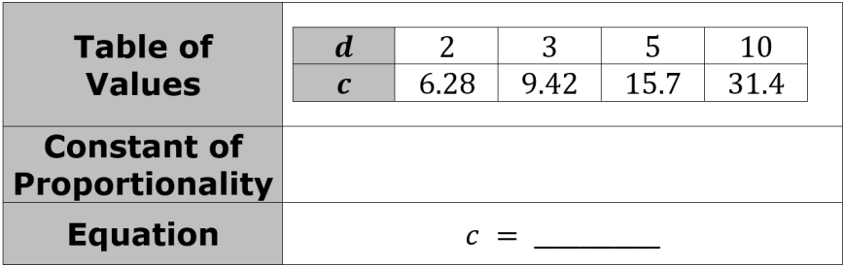
11.7.3 Guided Practice: Translating Between Different Representations of Proportional Relationships
Each table represents a proportional relationship.
Find the constant of proportionality and write an equation that represents the relationship.
Find the constant of proportionality and write an equation that represents the relationship.
volume 2, pg. 184

Slide 15
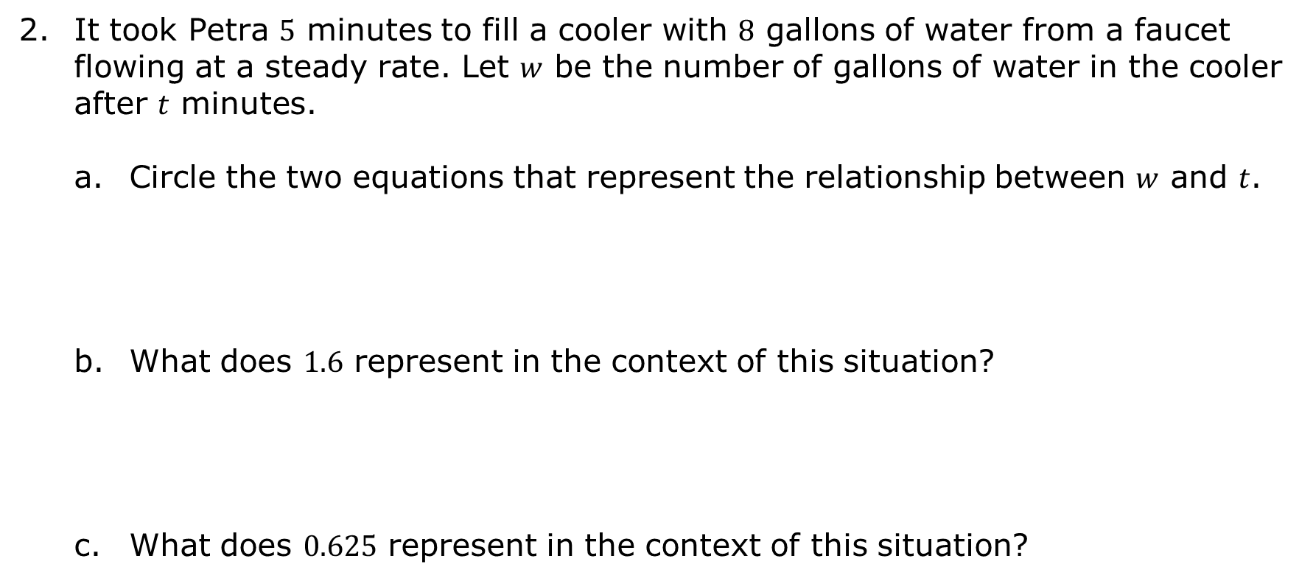
It took Petra $5$ minutes to fill a cooler with $8$ gallons of water from a faucet flowing at a steady rate. Let $w$ be the number of gallons of water in the cooler after $t$ minutes.
Circle the two equations that represent the relationship between $w$ and $t$.
What does $1.6$ represent in the context of this situation?
What does $0.625$ represent in the context of this situation?
$$w=1.6t$$ | $$w=0.625t$$ | $$t=1.6w$$ | $$t=0.625w$$
volume 2, pg. 185

Slide 16
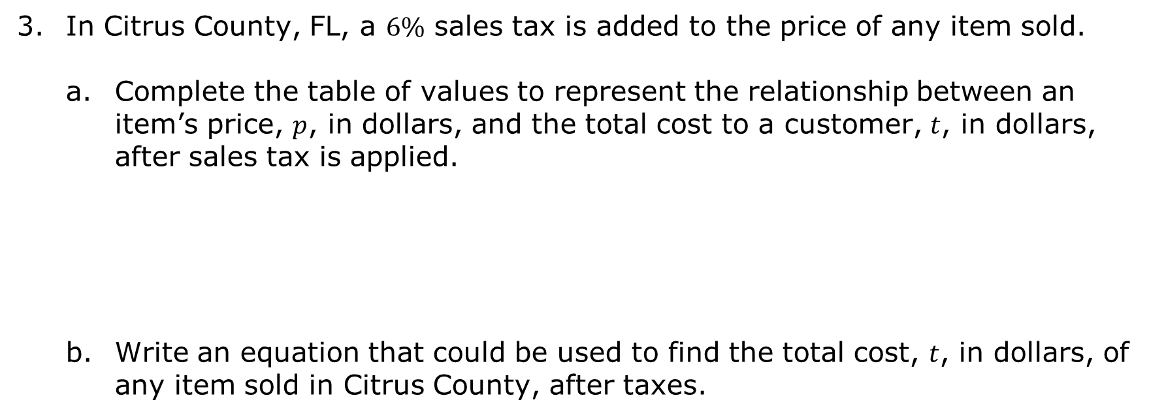
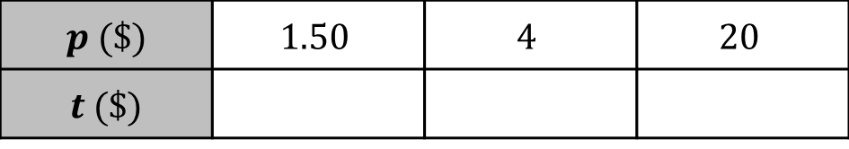
In Citrus County, FL, a $6\%$ sales tax is added to the price of any item sold.
Complete the table of values to represent the relationship between an item’s price, $p$, in dollars, and the total cost to a customer, $t$, in dollars, after sales tax is applied.
Write an equation that could be used to find the total cost, $t$, in dollars, of any item sold in Citrus County, after taxes.
$p$ ($) | $$1.50$$ | $$4$$ | $$20$$
$t$ ($)
volume 2, pg. 185

Slide 17

Collaboration
volume 2, pg. 186

Slide 18

11.7.4 Collaboration: Matching Equations to Graphs
Several equations are shown.
Work with your partner to match each equation to the graph representing the same relationship. Write the equation in the space provided below each graph.
$y=2x$ | $y=\frac{4}{5}x$ | $y=\frac{1}{4}x$ | $y=\frac{2}{3}x$ | $y=\frac{4}{3}x$ | $y=\frac{3}{2}x$
volume 2, pg. 186

Slide 19
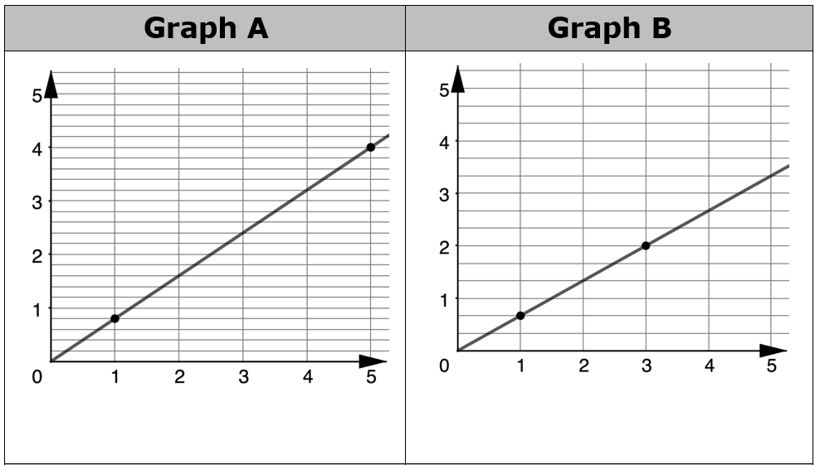
$y=2x$ | $y=\frac{4}{5}x$ | $y=\frac{1}{4}x$ | $y=\frac{2}{3}x$ | $y=\frac{4}{3}x$ | $y=\frac{3}{2}x$
volume 2, pg. 186

Slide 20
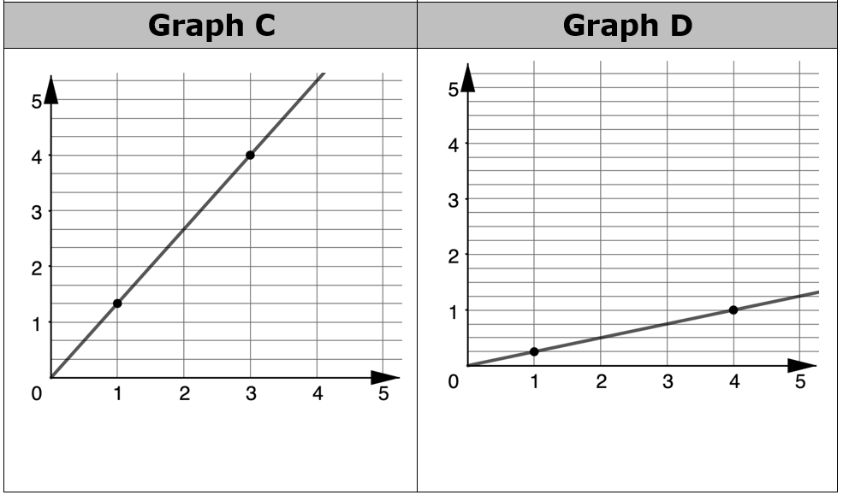
$y=2x$ | $y=\frac{4}{5}x$ | $y=\frac{1}{4}x$ | $y=\frac{2}{3}x$ | $y=\frac{4}{3}x$ | $y=\frac{3}{2}x$
volume 2, pg. 186

Slide 21
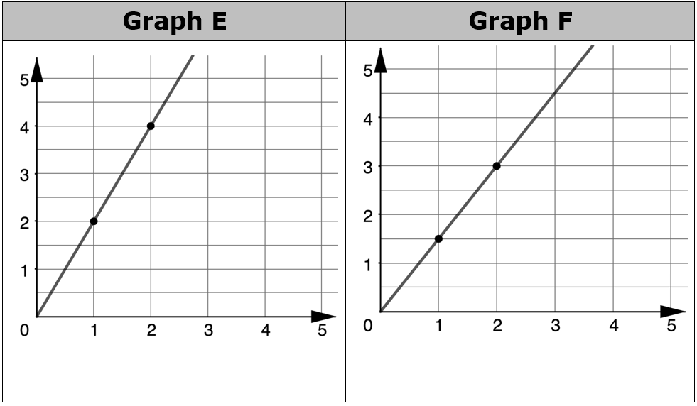
$y=2x$ | $y=\frac{4}{5}x$ | $y=\frac{1}{4}x$ | $y=\frac{2}{3}x$ | $y=\frac{4}{3}x$ | $y=\frac{3}{2}x$
volume 2, pg. 186

Slide 22
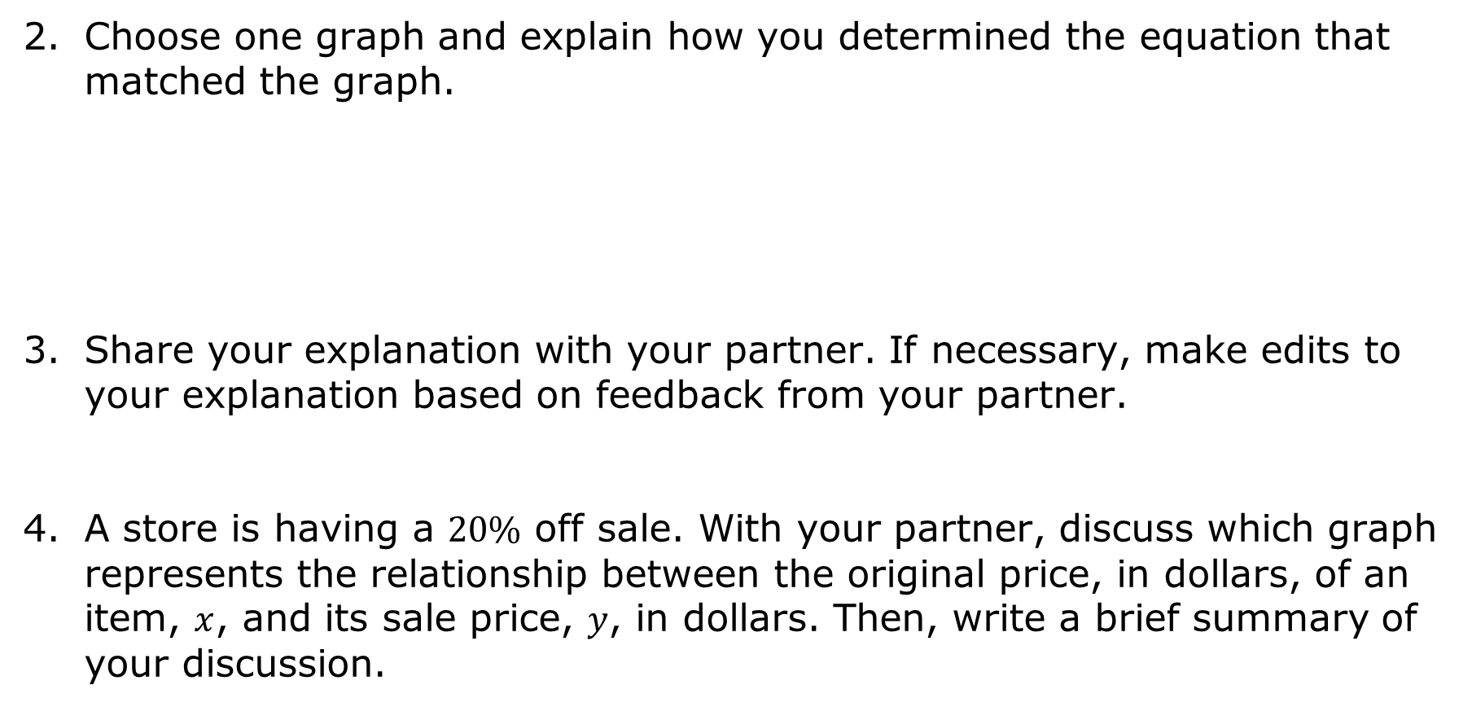
Choose one graph and explain how you determined the equation that matched the graph.
Share your explanation with your partner. If necessary, make edits to your explanation based on feedback from your partner.
A store is having a $20\%$ off sale. With your partner, discuss which graph represents the relationship between the original price, in dollars, of an item, $x$, and its sale price, $y$, in dollars. Then, write a brief summary of your discussion.
volume 2, pg. 186

Slide 23

Wrap-Up
volume 2, pg. 187

Slide 24

11.7.5 Wrap-Up: Reflection
What was the muddiest (most difficult or confusing) point in today’s lesson on translating proportional relationships to written descriptions, tables, or equations?
volume 2, pg. 187

